Slide 1
FINAL PROJECT
Design and Implementation of an E-Learning Platform
A web-based course marketplace for students, instructors, and administrators
Prepared by: [Your Full Name] Index Number: [Your Index Number] Computer Science Department | Kumasi Technical University
2026
Notes:
Open with your name, programme and project title. Do not read the title slide. In one sentence say that the project is a secure web-based e-learning marketplace built for students, instructors and administrators.

Slide 2
Background and Problem
Why a locally relevant e-learning marketplace is needed
THE GAP
Online learning is growing, but existing platforms leave important needs unmet in the African context.
01
02
03
Local payment barrier
Weak content governance
Trust and security concerns
Many global platforms rely on international cards, which can exclude learners who depend on local cards or mobile money.
Open marketplaces can allow unreviewed content to reach learners before a proper approval decision is made.
Weak account controls, unclear records, and poor payment handling discourage both learners and instructors.
Design question: Can one low-cost platform combine local payment, content approval, and secure role-based access?
SECURE E-LEARNING MARKETPLACE | PROJECT DEFENCE
2
Notes:
Present the three gaps clearly. Avoid criticising platforms generally; explain that the project addresses a context-specific combination of local payment, governance and security.

Slide 3
Aim and Objectives
What the project set out to achieve
To design and implement a secure web-based e-learning marketplace.
1
Separate student, instructor, and administrator privileges.
2
Support course creation, review, approval, and publication.
3
Protect accounts through secure authentication and audit logs.
The platform supports role-based course management, local payment, automated assessment, and transparent revenue sharing.
4
Enable free and paid enrolment with automatic revenue sharing.
5
Provide timed quizzes, automatic grading, and progress tracking.
SECURE E-LEARNING MARKETPLACE | PROJECT DEFENCE
3
Notes:
Read the aim once. Then summarise the objectives instead of reading them word for word. The key message is that the project covers the entire marketplace journey, not only course delivery.

Slide 4
Proposed Solution
One platform, three roles, controlled access
1
2
3
STUDENT
INSTRUCTOR
ADMINISTRATOR
Browse approved courses Enrol, learn and track progress Take quizzes, review and message
Apply for approval Create courses and assessments View earnings and request withdrawals
Approve instructors and courses Manage users and withdrawals Monitor analytics and audit logs
Core journey
Create account
Approved course
Enrol & pay
Learn & assess
Track outcome
SECURE E-LEARNING MARKETPLACE | PROJECT DEFENCE
4
Notes:
Introduce the actors before demonstrating the interface. Emphasise that role separation is enforced by the server, not just hidden in the user interface.

Slide 5
System Architecture
Three tiers, with external services isolated from the client
Presentation tier
Application tier
Data tier
Next.js application
Browser
PostgreSQL
Server Components | Server Actions API routes | Middleware Validation | Domain services
Responsive React interface Pages, forms, dashboards Mobile and desktop access
Prisma ORM Users, courses, payments Progress and audit records
External services
Paystack
Payment processing
Google SMTP
Email and verification
Blob storage
Files and documents
Google
OAuth sign-in
E-LEARNING PLATFORM
5
Notes:
Walk left to right. The browser never sees a database credential or secret key. Server-side actions and route checks are why a student cannot reach administrative functions by editing the browser URL.

Slide 6
Key Workflows
The controls that protect course quality and payment processing
Course approval workflow
Draft
Pending review
Approved
Published
Rejected courses return to the instructor with a reason. Hidden courses are removed from the catalogue while enrolled learners keep access.
Paid enrolment workflow
Student enrols
Payment pending
Paystack verifies
Enrol + credit
Reliability safeguard: browser callback and Paystack webhook use the same idempotent completion process, so a payment cannot be credited twice.
SECURE E-LEARNING MARKETPLACE | PROJECT DEFENCE
6
Notes:
This slide is important. Explain that approval prevents unreviewed content from reaching customers. Then explain idempotency in plain language: even if two payment confirmations arrive, the system processes the sale only once.

Slide 7
Security and Reliability Controls
Controls implemented to protect users, content, and payments
01
02
03
Role-based access
Password protection
Rate limiting
Middleware and server-side role checks.
bcrypt hashing and password rules.
Database-backed protection against abuse.
04
05
06
Signed quiz sessions
Payment verification
Audit trail
Server-controlled attempt start time.
Verified transaction and idempotent processing.
Sensitive actions recorded for accountability.
Security is a design requirement rather than a later add-on.
SECURE E-LEARNING MARKETPLACE | PROJECT DEFENCE
7
Notes:
Do not rush this slide. Pick two controls to explain in detail if the panel asks: role checks protect areas by user type, and idempotent payment processing prevents duplicate crediting.

Slide 8
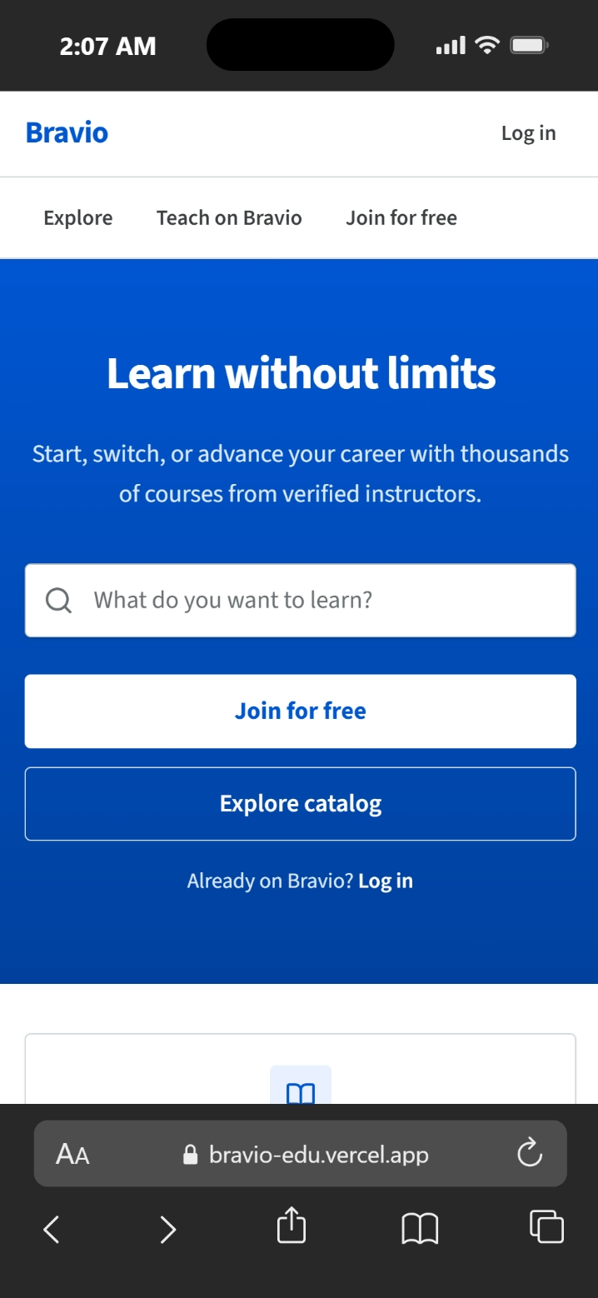
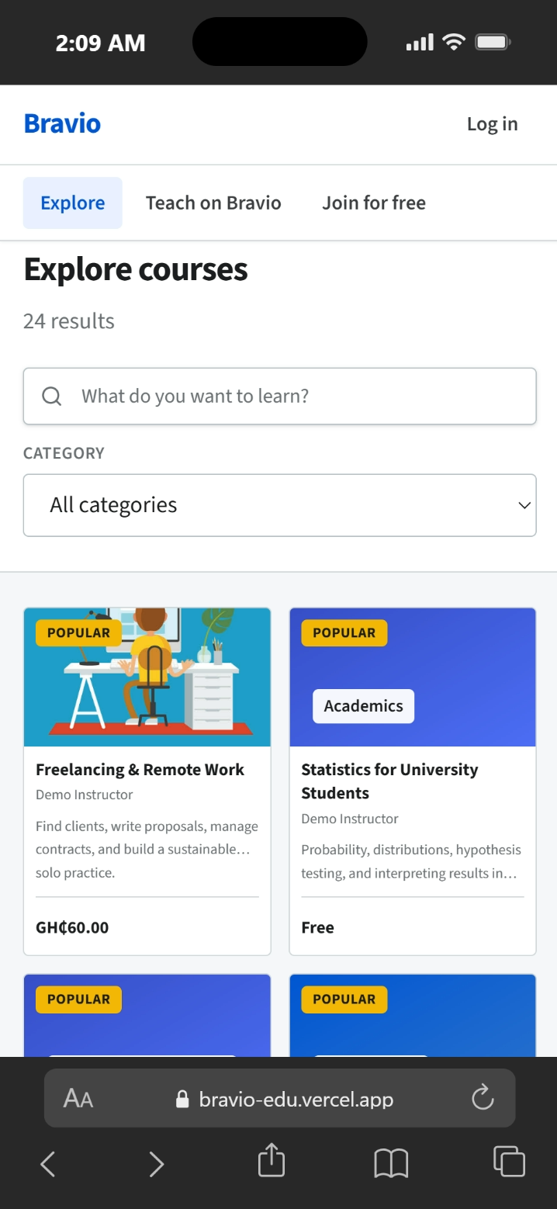
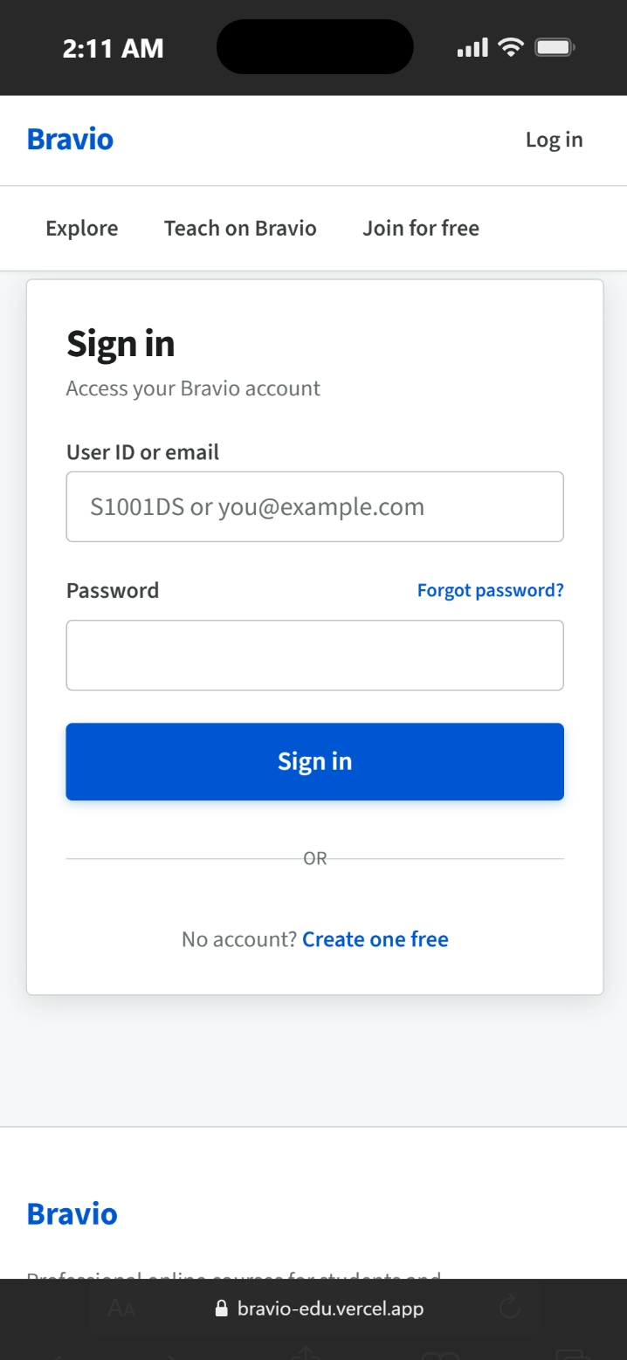
Public and Authentication Experience
The first screens seen by a visitor, shown on a mobile browser
Landing page
Course catalogue
Sign-in
Clear entry points to explore, teach, and join.
Search, category filtering, and published course cards.
Users may sign in with a user ID or email address.
SECURE E-LEARNING MARKETPLACE | PROJECT DEFENCE
8
Notes:
Use this slide briefly. It establishes that the interface is responsive. Mention that the user ID option is useful where users may not remember the email address they registered with.

Slide 9
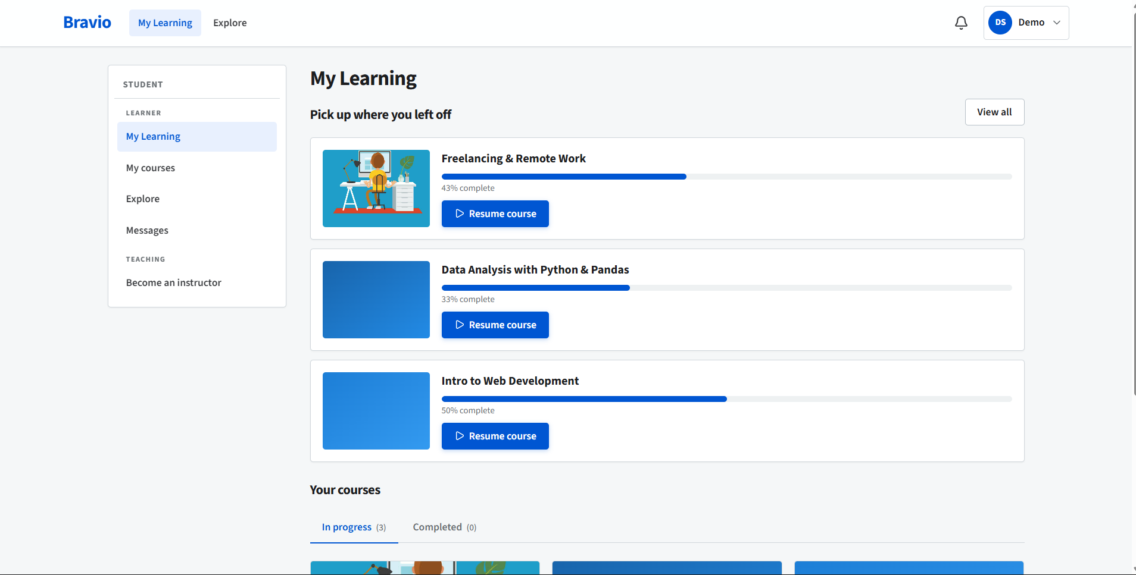
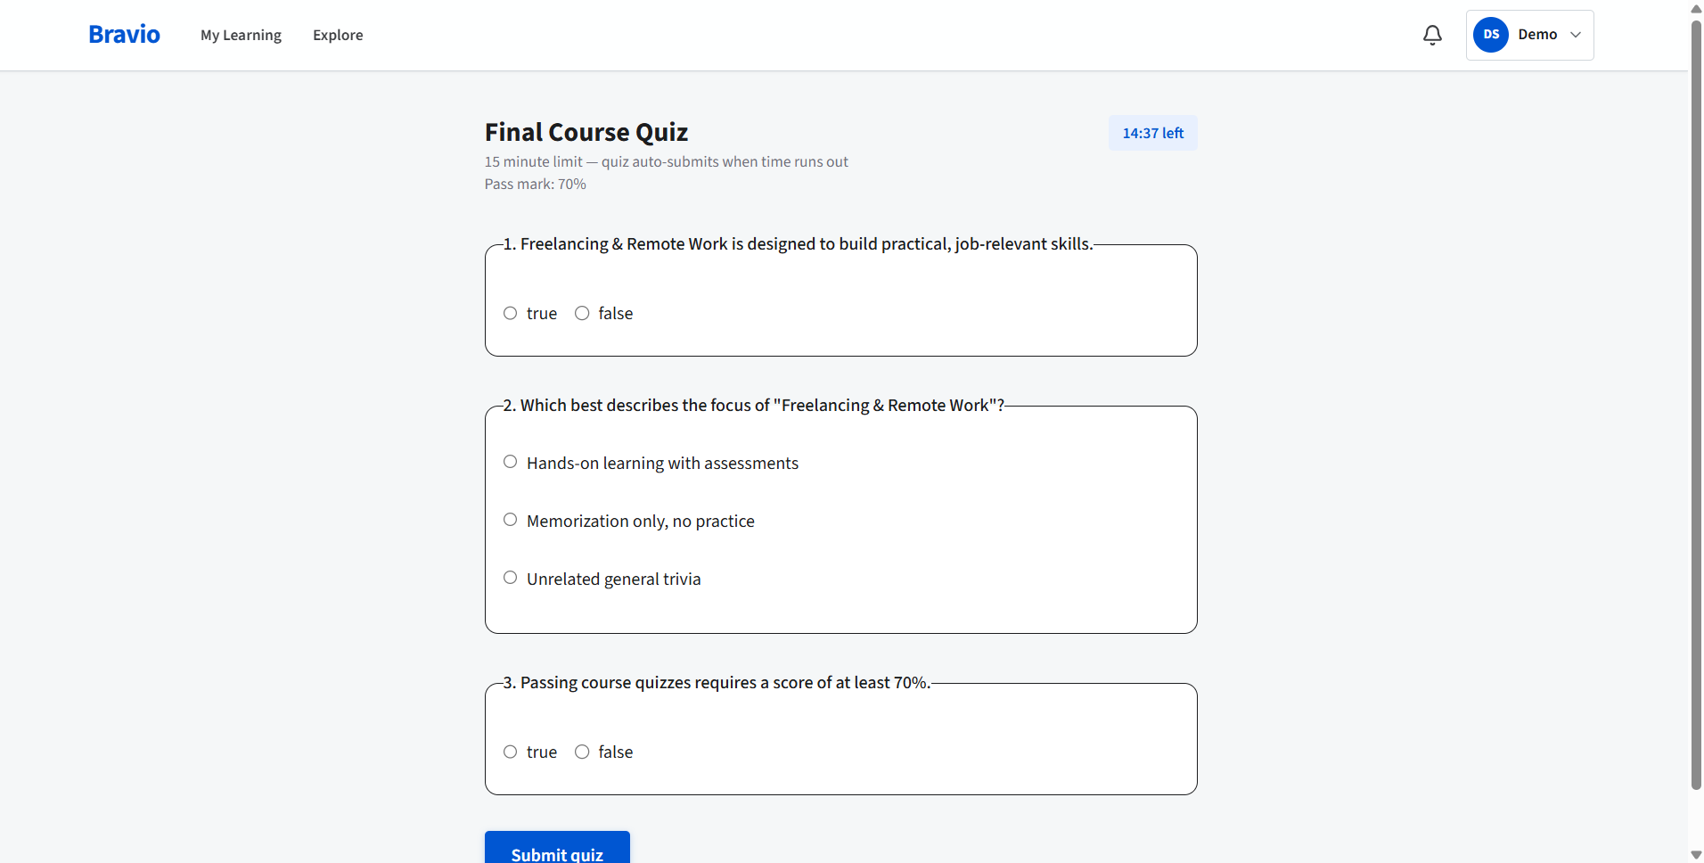
Student Learning Experience
Course progress and timed automatic assessment
PROGRESS
+
Lessons
+
Passed quizzes
=
Student dashboard
Timed quiz
Course completion
Enrolled courses, current progress, and a continue-learning route.
Automatic marking, pass score, and an attempt protected by a signed token.
SECURE E-LEARNING MARKETPLACE | PROJECT DEFENCE
9
Notes:
Explain how a student moves through the system: enrol, open a course, complete lessons, take required quizzes, and see progress update. The quiz result is calculated on the server and a passed quiz contributes to course completion.

Slide 10
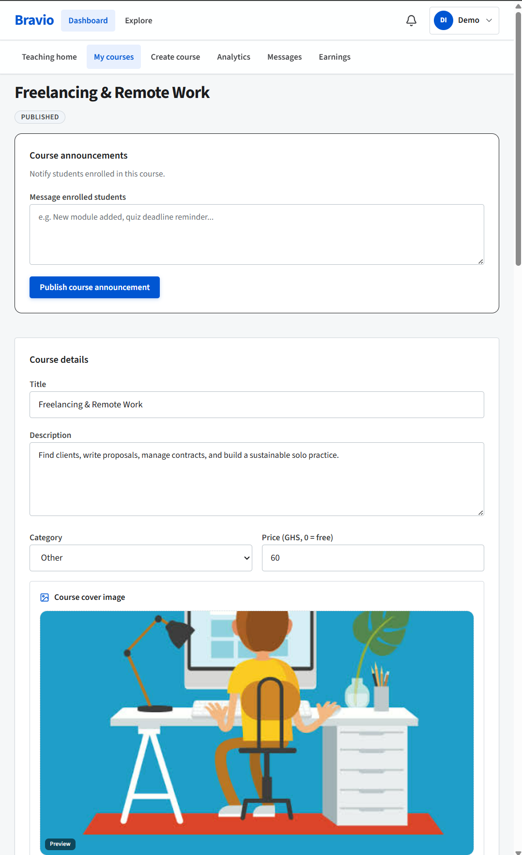
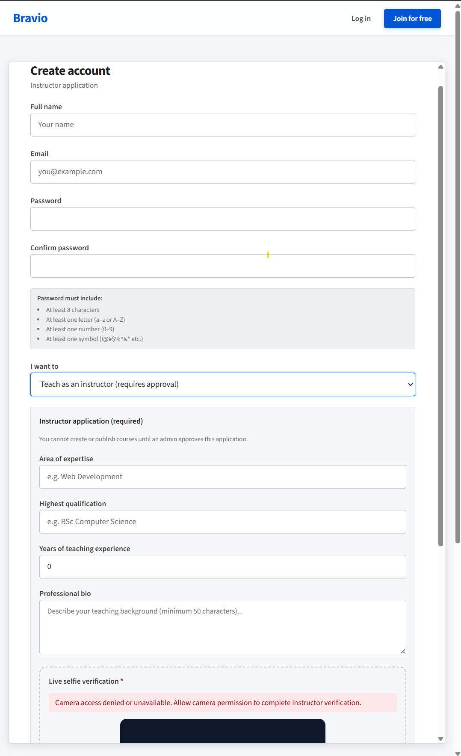
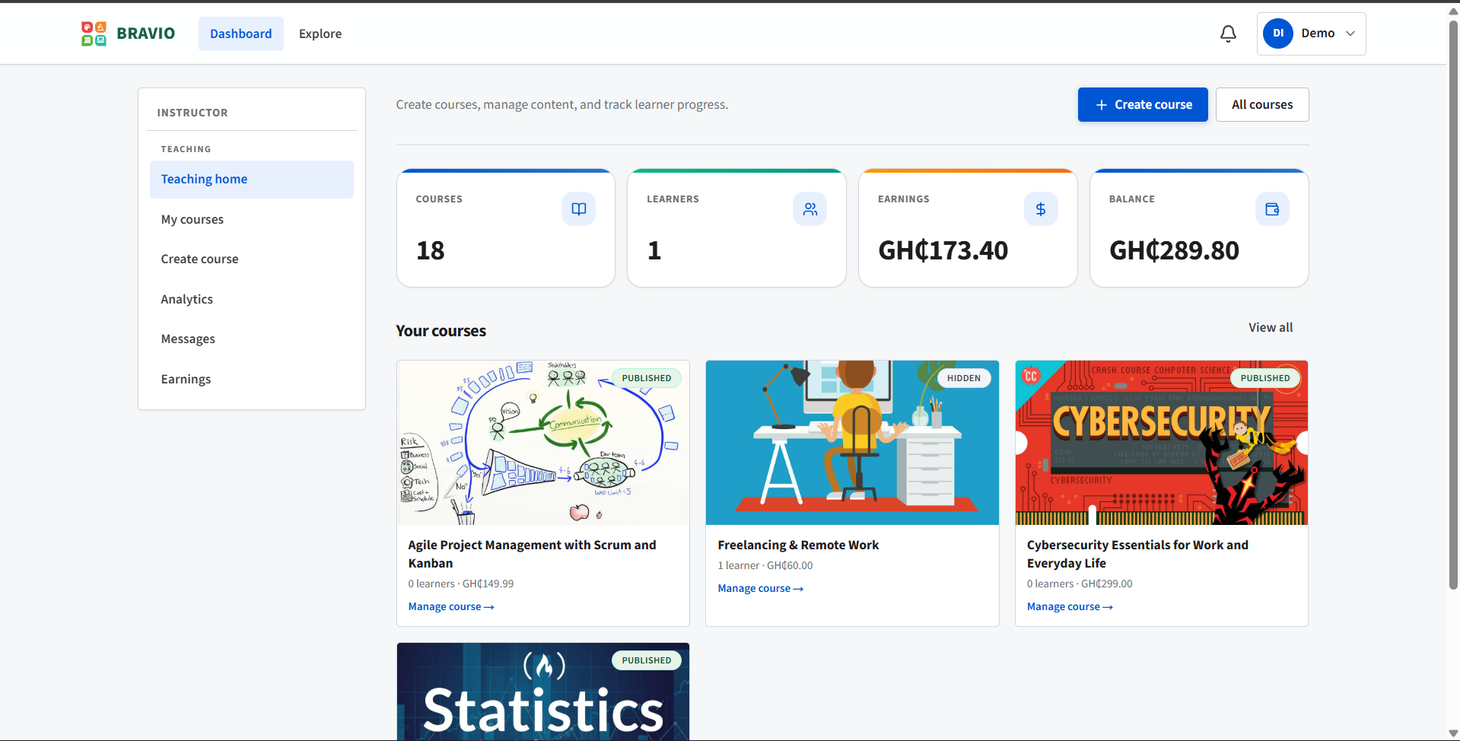
Instructor Experience
From application to course management and earnings
Instructor application
Instructor dashboard
Course editor
Application details are reviewed before instructor tools become available.
Courses, learners, earnings, and withdrawal information in one view.
Build modules, add lessons, create quizzes, then submit the course for review.
Instructor access is enabled only after administrative approval.
SECURE E-LEARNING MARKETPLACE | PROJECT DEFENCE
10
Notes:
The instructor cannot publish straight to learners. Explain the approval state first, then show that the approved instructor gets content tools, earnings information and a withdrawal process.

Slide 11
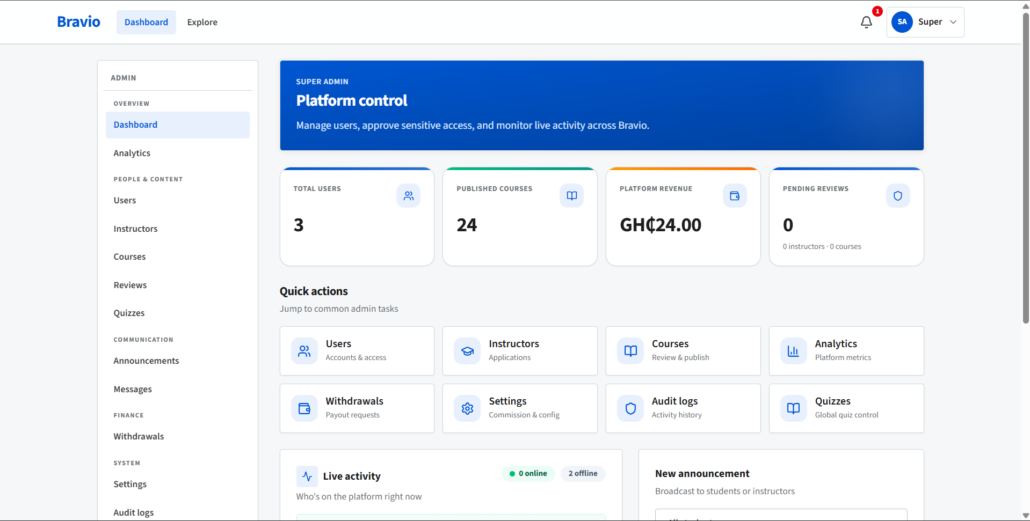
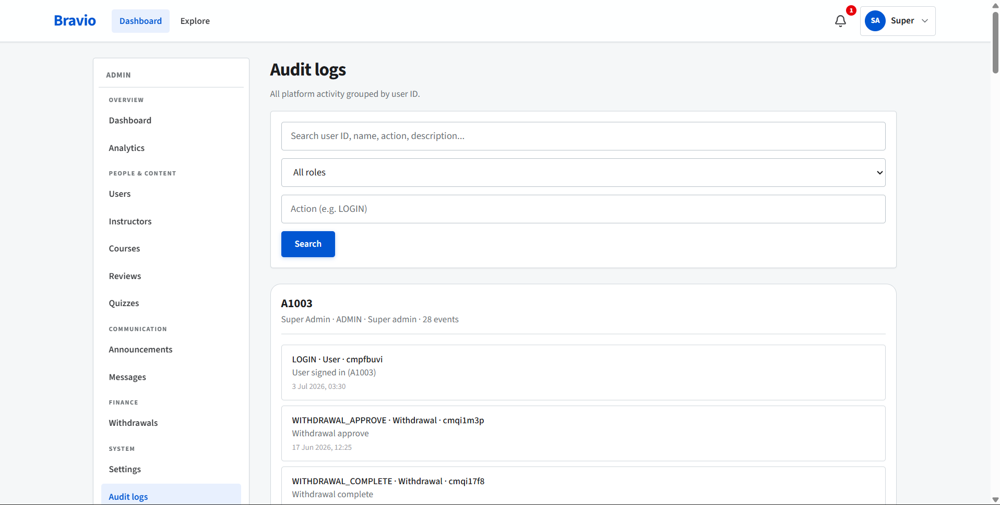
Administration and Accountability
Governance, moderation, and traceability
Admin command centre
Audit log
Manage users, instructors, course approvals, withdrawals, announcements, and settings.
Sensitive actions are recorded to support accountability and investigation.
Administrative controls complete the trust model: instructor verification + course review + traceable actions.
SECURE E-LEARNING MARKETPLACE | PROJECT DEFENCE
11
Notes:
This is the other side of the platform. Highlight that administration is not just a dashboard; it is how the platform enforces trust, approves content and keeps an audit trail of sensitive decisions.

Slide 12
Testing and Evaluation
Functional, integration, and user-acceptance tests
22
3
100%
mapped test cases
testing levels
listed cases passed
Area | Example verified | Result
Authentication | Weak password, suspended account, user-code login | Passed
Course workflow | Draft → pending → approved → published | Passed
Payment | Successful payment and duplicate-event handling | Passed
Assessment | Auto-grading, timer, forged token rejection | Passed
Access control | Student attempts to open admin routes | Passed
Governance | Withdrawal limits and audit logging | Passed
E-Learning Platform Project
12
Notes:
State the three testing levels: unit, integration, and user acceptance. Say that all 22 mapped cases passed. Use only two examples: a duplicate payment event did not credit an instructor twice, and a student was blocked from an admin route. The findings are positive, but the project also has clear limitations.

Slide 13
Findings, Limitations, and Future Work
What the project proved, and what remains outside its present scope
ACHIEVED
LIMIT
NEXT
Working marketplace
Not production scale
Real-world extension
A multi-role platform with controlled course publication, free/paid enrolment, learning tools, quizzes, and traceable administration.
Payments were tested in a sandbox, and heavy-load performance was not measured on production infrastructure.
Live payment operation, load testing, a wider user study, offline support, and richer assessment types.
Conclusion: a small team can build a secure and locally relevant e-learning marketplace using modern, low-cost tools.
SECURE E-LEARNING MARKETPLACE | PROJECT DEFENCE
13
Notes:
Give a balanced conclusion. The system meets its scope and passes the mapped tests, but it has not been proven at production scale. Future work should take it from a tested project artefact to wider real-world deployment.

Slide 14
THANK YOU
Questions and live demonstration
The system is ready to demonstrate: - student learning and quiz attempt - instructor course management - administrator approval and audit trail
Secure E-Learning Marketplace | Project Defence
Notes:
Thank the panel, then offer the live demo. Keep separate browser tabs ready for the student, instructor, and administrator accounts. If the network is unavailable, use the screenshots in this deck as the fallback evidence.

